Slide 1
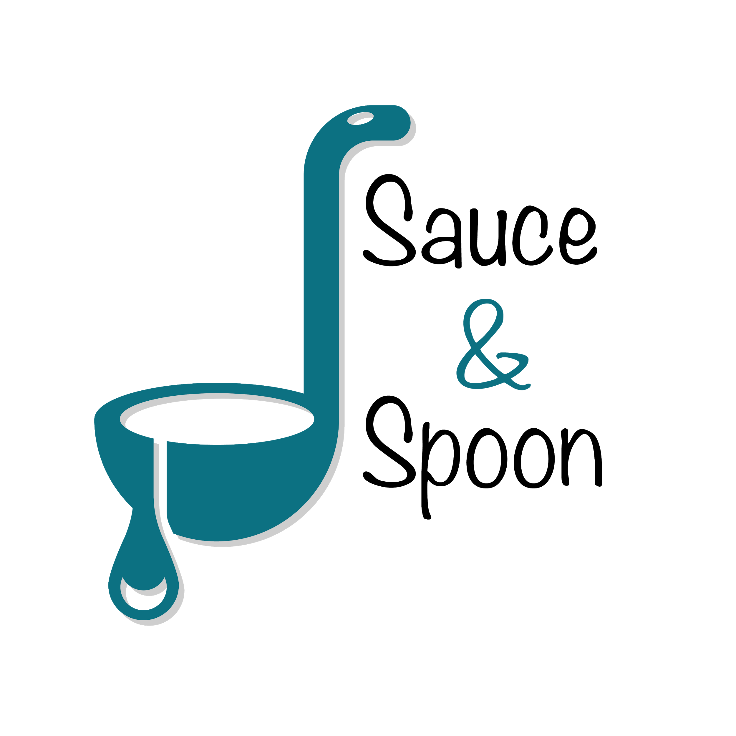
Sauce & Spoon Test Launch Findings

Slide 2
Summary
Implement the tablet project which is running smoothly with lesser complain
Process order and payment through the tablet along with coupon and other food suggestions
Decreased the food delivery time and reduce food loss due to wrong order placement
Increases customer satisfaction and retention rate

Slide 3
Overview
Team wants to measure the tablet functionality whether working correctly or not and collected the feedback through customer survey
Team wanted to measure whether the food delivery time reduced and the food wastage amount has reduced or not through the time of food delivery and reduced case of wrong food order
Team wanted to check whether the customer satisfaction has increased through checking the ratings values provided by the customer
Team wanted to check whether sales has increased and the customer retention rate has increase or not

Slide 4
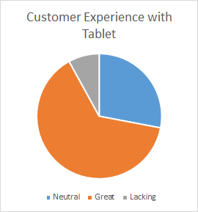
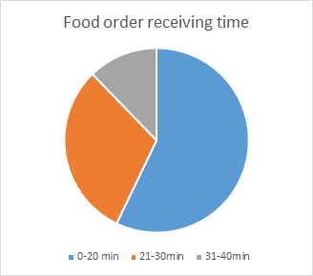
Findings

Slide 5
Next Steps
Ensure more interactive manuals so that customers are able to place the correct order

Slide 6
Next Steps
Enhance the navigation bar for menu list so that clients can place order more efficiently and quickly

